Slide 1
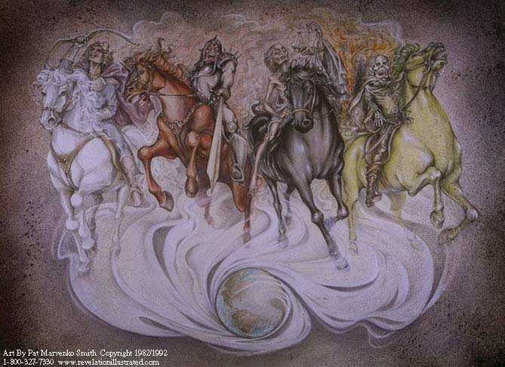
4 Horsemen “Progression”
1
Determination to conquer
2
Killing; bloodshed
3
Inflation; food = day’s wage
Death by:
Sword; hunger; plague; beasts
4
Notes:
Prior to Chapter 7 coming off of Chapter 6
If I take a symbol beyond its Revelation and Historical context, then I am teaching
Opinion as truth
Lie as truth
Both
5 – Souls of slain beneath altar of God
6 – Evil receives wrath of God

Slide 2
Contextual Interpretation
Interpretation of Revelation Verses/Symbols
(must follow this order)
Consistent with surrounding verses
Consistent with chapter
Consistent with Revelation Tribulation
Consistent with history of time period
Consistent with remainder of Bible
Notes:
Prior to Chapter 7 coming off of Chapter 6
People who do not follow this pattern are trying to be the smartest people in the room.

Slide 3
Contextual Interpretation
My Knowledge of Revelation Reside In:
Revelation
Accept what Revelation gives you
Tribulation characteristics
New Jerusalem characteristics
Villain characteristics
History
In which Revelation was written
Bible
Best commentary on Revelation
Dependable and Defendable
Notes:
My “insight” in Revelation depend upon Revelation, History, and Bible.
Going beyond that will get you into all kinds of trouble.
“I don’t know” is a legitimate answer to difficult verses in Revelation.

Slide 4
Revelation 7

Slide 5
Numerology
Numerology
Study of usage of numbers
Numbers are critical to Revelation
Numbers help us understand Revelation
Numbers have meaning/usage today
We’re # 1
Lucky 7
Unlucky 13
“If I’ve told you once, I’ve told you 1000 times”
Multiplication used symbolically = “many”
Forgive brother 7 times? 70 x 7 (Matt 18:22)
Notes:
Slides are verbose to make them easier to study
Great Is Thy Faithfulness
“Great Is Thy Faithfulness”
[3] Pardon for sin and a peace that endureth, Thine own dear presence to cheer and to guide, Strength for today and bright hope for tomorrow— Blessings all mine, with ten thousand beside!
“Lily of the Valley”
He’s the Lily of the Valley
The Bright and Morning Star
He’s the fairest of ten thousand to my soul.
Revelation multiplies numbers with 1000 to mean a combination of “many” plus meaning of the other number that it is multiplied with.
Jesus multiplied 2 numbers together.

Slide 6
Numerology
4 = earth-centered
Winds
Compass directions
Corners of the earth
Beasts around throne (lion, calf, man, eagle)
7 = complete, religious implications
God rested on 7th day (Sabbath)
Passover = 7 days
Famine every 7 years
Lev 4:6 – Priest sprinkled blood 7x on Ark
Jericho – 7 days; 7 times on 7th day
Naaman dipped 7 times in Jordan River
Many instances in Revelation

Slide 7
“7’s” of Revelation
7 churches (1)
7 spirits of God (1, 4, 5)
7 golden lampstands (1, 20)
7 stars (1, 20)
7 lamps of fire (4)
7 seals on the scroll (5, 6)
7 horns of the Lamb (5)
7 eyes of the lamb (5)
7 angels (8, 10, 11, 15, 16, 17, 21)
7 trumpets (6, 8)
7 thunders (10)
7 thousands slain in earthquake (11)
7 heads of the dragon (12, 13, 17)
7 crowns (12)
7 heads of the beast (13)
7 final plagues (15)
7 angels from temple (15)
7 bowls of wrath (15,16,17,21)
7 heads of scarlet beast (17)
7 mountains / hills (17)
7 kings + 1 (17)

Slide 8
Numerology
10 = complete
Whole, All
12 = God’s people
12 tribes of Israel
12 Apostles
12 Tribes + 12 Apostles = 24 “elders” of throne?
Other theories of 24, also
12 x 1000 = 12,000 per tribe
(12 x 1000) x 12 Tribes = 144,000

Slide 9
Numerology
3 ½ years
42 months
1,260 days
Time, times, and a half time (Ch. 12)
Rev 12:6,14 - equals 1,260 days
In books of Daniel and Revelation
Context = unstable period of time
Indicates persecution or slavery
1000 = many
Notes:
12 very familiar number associated with God’s people
1000 used to mean “many”
Strange? No, we use 1000 for same meaning
“If I told you once, I’ve told you 1000 times . . . “

Slide 10
Revelation 7:1-8
Revelation 7:1-3
Something big is ready to happen
4 angels at 4 corners of earth holding winds
Revelation 7:4-8
144,000: God symbolically identifying his people
(12 x 1000) x 12 (many from each tribe x 12 tribes)
Multiplication used symbolically = “many”
Forgive brother 7 times? 70 x 7 (Matt 18:22)
Bible is excellent commentary on Revelation
Jehovah’s Witnesses ¹
144,000 only going to heaven (others on earth or cease to exists)
¹ https://www.gotquestions.org/Jehovahs-Witnesses-144000.html

Slide 11
Revelation 7:9-14
Revelation 7:9
Great multitude in heaven no one can number
Myriads of myriads (Rev 5:11)
Proof = large numbers represent uncountable numbers
Revelation 7:10-12
Worship scene in heaven
Revelation 7:13-14
Saints from the Tribulation (already discussed)
Murder saints from Tribulation:
In Paradise or Heaven?
Revelation 7:15-17
Description of Heaven
Notes:
Revelation 7:1-3
Angels standing at 4 corners of the earth holding back 4 winds
Hurt nothing until God has identified (sealed) his servants
Rev 7:9
Palms leaves in their hands = peace
v v v v v v v v v v v v v v v v v v v v v v v v v v
If we interpret symbols consistently as mentioned above, we will find that some verses associated with other verses across chapter boundaries. Is this the case with Revelation 7? I will provide the evidence, but you will have to decide for yourself.

Slide 12
Missing Tribes?
1. What land-owning tribes are missing?
2. Why are they missing?
3. What does that have to do with me?
Notes:
3 Questions:
Which tribes are missing?
Why are they missing?
What does that have to do with me?

Slide 13
Missing Tribes?
1. What land-owning tribes are missing?
2. Why are they missing?
3. What does that have to do with me?
Notes:
3 Questions:
Which tribes are missing?
Why are they missing?
What does that have to do with me?

Slide 14
Missing Tribes?
Revelation 7:5-8
⁵ Of the tribe of Judah were sealed twelve thousand.
Of the tribe of Reuben were sealed twelve thousand.
Of the tribe of Gad were sealed twelve thousand.
⁶ Of the tribe of Asher were sealed twelve thousand.
Of the tribe of Nepthalim were sealed twelve thousand.
Of the tribe of Manasses were sealed twelve thousand.
⁷ Of the tribe of Simeon were sealed twelve thousand.
Of the tribe of Levi were sealed twelve thousand.
Of the tribe of Issachar were sealed twelve thousand.
⁸ Of the tribe of Zabulon were sealed twelve thousand.
Of the tribe of Joseph were sealed twelve thousand.
Of the tribe of Benjamin were sealed twelve thousand.
Notes:
1. What land-owning tribes are missing?
Dan and Ephraim
Some claim that “Joseph” represents his 2 sons
Can’t be true – Manasses is 3rd name listed in verse 6

Slide 15
Missing Tribes?
1. What land-owning tribes are missing?
2. Why are they missing?
3. What does that have to do with me?
Notes:
2. Why are they missing?
No one knows for sure
Ephraim
Jeremiah 7:15:
Hosea 4:17: Ephraim started worshipping idols
Hosea 5:9, 11; Ephraim will be laid waste for following after idols
Hosea 7:1-16
Hosea 13:1-3 !
Most of Hosea: Ephraim condemned
Dan
altar and golden calf in Dan for idol worship.
2 Kings 10:29: Golden calves in Dan
Judges 18:30: Dan started worshipping idols
Jeremiah 4:15
Dan’s name synonymous with idol worship – proper noun became an adjective
Accept Micah's idols, and later golden calve of Jeroboam, the Ephraimite
The Danites continued this idolatry until the Assyrian Empire took them captive in 722 B.C.
Amos 8:11-14
Last mention of Dan references their idolatry

Slide 16
Missing Tribes?
Ephraim
Judges 1:28-30
²⁸ And it came to pass, when Israel was strong, that they put the Canaanites to tribute, and did not utterly drive them out. ²⁹ Neither did Ephraim drive out the Canaanites that dwelt in Gezer; but the Canaanites dwelt in Gezer among them.
Jeremiah 7:15
¹⁵ And I will cast you out of my sight, as I have cast out all your brethren, even the whole seed of Ephraim.

Slide 17
Missing Tribes?
Ephraim
Largest of northern tribes
As Ephraim goes, so does northern kingdom
Ephraim’s name used to represent N. kingdom & idols
References
Jeremiah 7:15
Book of Hosea condemns Ephraim
Hosea 4:17
Hosea 5:9, 11
Hosea 7:1-16
Hosea 13:1-3 !

Slide 18
Missing Tribes?
Dan
Judges 18:30
²⁸ There the Danites set up for themselves the idol, and Jonathan son of Gershom, the son of Moses, and his sons were priests for the tribe of Dan until the time of the captivity of the land.
Name “Dan” used synonymously with an idol worshipper
“There goes a ‘Dan’.”

Slide 19
Missing Tribes?
Dan
1 Kings 12:26-29 & 2 Kings 10:29
Jeroboam – put altar and gold calf in Bethel and Tel Dan
Danites worshipped idols until Assyrian captivity ~721 BC
Judges 18:30
Dan worshipped idols
Jeremiah 4
Disaster for northern kingdom
Dan and Ephraim’s names are mentioned (verse 15)
Amos 8:11-14
Last mention of Dan in Bible

Slide 20
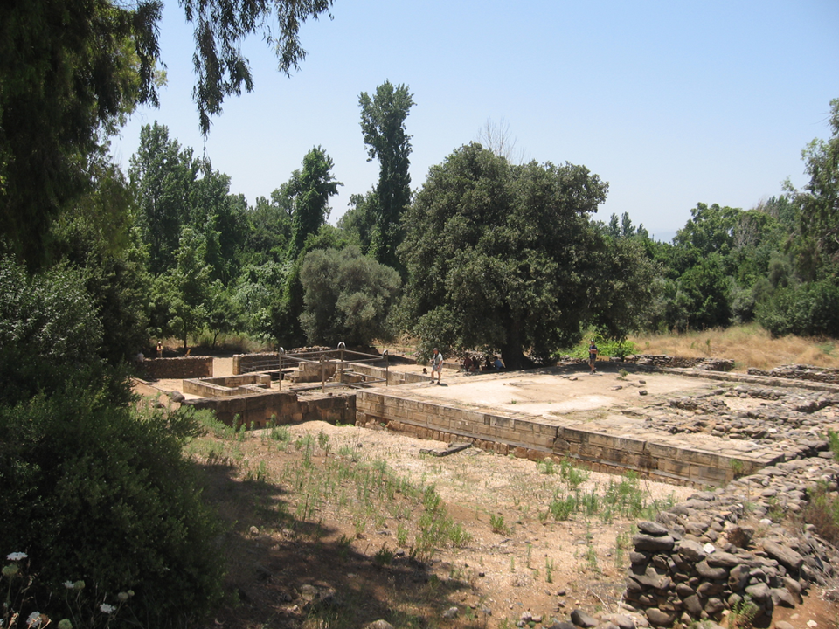
Notes:
Altar at Tel Dan (nation of Dan) built by King Jeroboam

Slide 21
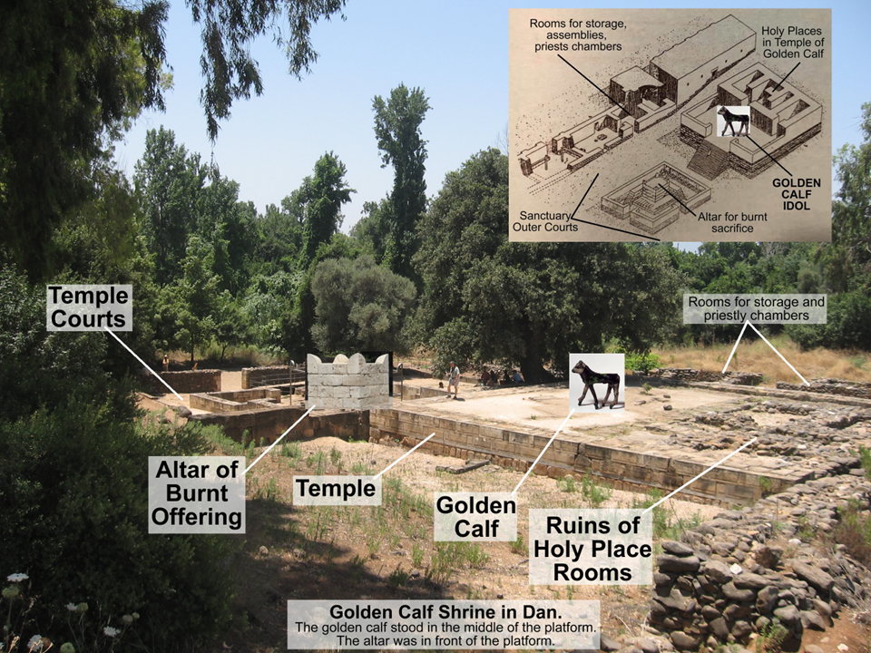
Notes:
Altar at Tel Dan (nation of Dan) built by King Jeroboam

Slide 22
Missing Tribes?
1. What land-owning tribes are missing?
2. Why are they missing?
3. What does that have to do with me?
Notes:
What does that have to do with me?
12 tribes most important entities in Old Testament – through the tribes that the Messiah would come
12 apostles most important entities in New Testament – through the apostles, we will learn about the Messiah and his will for us
24 most important entities in Bible, yet two are omitted from Revelation
If God holds 12 tribes accountable, why do I think I am going to get away with anything
“Oh, God will understand” , “God is not so mean that he will send me to Hell if I . . . “
Ask the Tribes of Dan and Ephraim if that is the way God works
Once saved always saved? No

